Slide 1
Chapter 23
Confidence Intervals and Hypothesis Tests for a Population Mean μ; t distributions
t distributions
Confidence intervals for a population mean μ
Sample size required to estimate μ
Hypothesis tests for a population mean μ

Slide 2
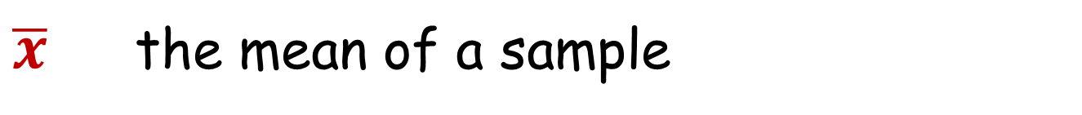
Review of statistical notation.
n the sample size
$\overline{x}$ the mean of a sample
s the standard deviation of a sample
μ the mean of the population from which the sample is selected
σ the standard deviation of the population from which the sample is selected

Slide 3
The Importance of the Central Limit Theorem
When we select simple random samples of size n, the sample means we find will vary from sample to sample. We can model the distribution of these sample means with a probability model that is

Slide 4
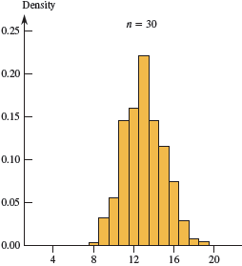
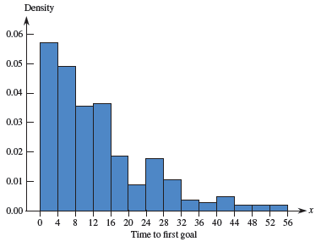
Time (in minutes) from the start of the game to the first goal scored for 281 regular season NHL hockey games from a recent season.
mean μ = 13 minutes, median 10 minutes.
Histogram of means of 500 samples, each sample with n=30 randomly selected from the population at the left.

Slide 5
Since the sampling model for x is the normal model, when we standardize x we get the standard normal z

Slide 6
If μ is unknown, we probably don’t know σ either.
The sample standard deviation s provides an estimate of the population standard deviation σ
For a sample of size n,
the sample standard deviation s is:
n − 1 is the “degrees of freedom.”
The value s/√n is called the standard error of x , denoted SE(x).

Slide 7
Standardize using s for σ
Substitute s (sample standard deviation) for σ
s
s
s
s
s
s
s
s
Note quite correct to label expression on right “z”
Not knowing σ means using z is no longer correct

Slide 8
t-distributions
Suppose that a Simple Random Sample of size n is drawn from a population whose distribution can be approximated by a N(µ, σ) model. When σ is known, the sampling model for the mean x is N(μ, σ/√n), so is approximately Z~N(0,1).
When s is estimated from the sample standard deviation s, the sampling model for follows a
t distribution with degrees of freedom n − 1.
is the 1-sample t statistic

Slide 9
Confidence Interval Estimates
CONFIDENCE INTERVAL for μ
where:
t = Critical value from t-distribution with n-1 degrees of freedom
= Sample mean
s = Sample standard deviation
n = Sample size
For very small samples (n < 15), the data should follow a Normal model very closely.
For moderate sample sizes (n between 15 and 40), t methods will work well as long as the data are unimodal and reasonably symmetric.
For sample sizes larger than 40, t methods are safe to use unless the data are extremely skewed. If outliers are present, analyses can be performed twice, with the outliers and without.

Slide 10
t distributions
Very similar to z~N(0, 1)
Sometimes called Student’s t distribution; Gossett, brewery employee
Properties:
i) symmetric around 0 (like z)
ii) degrees of freedom ν

Slide 11
Student’s t Distribution
Z
-3
-2
-1
0
1
2
3
-3
-2
-1
0
1
2
3

Slide 12
Student’s t Distribution
Z
t
-3
-2
-1
0
1
2
3
-3
-2
-1
0
1
2
3
Figure 11.3, Page 372

Slide 13
Student’s t Distribution
Degrees of Freedom
Z
t₁
-3
-2
-1
0
1
2
3
-3
-2
-1
0
1
2
3
Figure 11.3, Page 372

Slide 14
Student’s t Distribution
Degrees of Freedom
Z
t₁
t₇
-3
-2
-1
0
1
2
3
-3
-2
-1
0
1
2
3
Figure 11.3, Page 372

Slide 15
t-Table: back of text
90% confidence interval; df = n-1 = 10
Degrees of Freedom
0.80
0.90
0.95
0.98
0.99
1
3.0777
6.314
12.706
31.821
63.657
2
1.8856
2.9200
4.3027
6.9645
9.9250
.
.
.
.
.
.
.
.
.
.
.
.
10
1.3722
1.8125
2.2281
2.7638
3.1693
.
.
.
.
.
.
.
.
.
.
.
.
100
1.2901
1.6604
1.9840
2.3642
2.6259
1.282
1.6449
1.9600
2.3263
2.5758

Slide 16
Student’s t Distribution
P(t < -1.8125) = .05
P(t > 1.8125) = .05
.90
.05
.05
t₁₀
-1.8125
0
1.8125

Slide 17
Comparing t and z Critical Values
Conf.
level n = 30
z = 1.645 90% t = 1.6991
z = 1.96 95% t = 2.0452
z = 2.33 98% t = 2.4620
z = 2.58 99% t = 2.7564

Slide 18
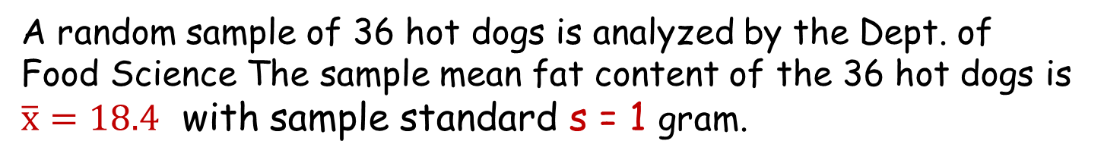
Hot Dog Fat Content
The NCSU cafeteria manager wants a 95%
confidence interval to estimate the fat content of the brand of hot dogs served in the campus cafeterias.
A random sample of 36 hot dogs is analyzed by the Dept. of Food Science The sample mean fat content of the 36 hot dogs is $\overline{x}=18.4$ with sample standard s = 1 gram.
Degrees of freedom = 35; for 95%, t = 2.0301
We are 95% confident that the interval (18.0616, 18.7384) contains the true mean fat content of the hot dogs.

Slide 19

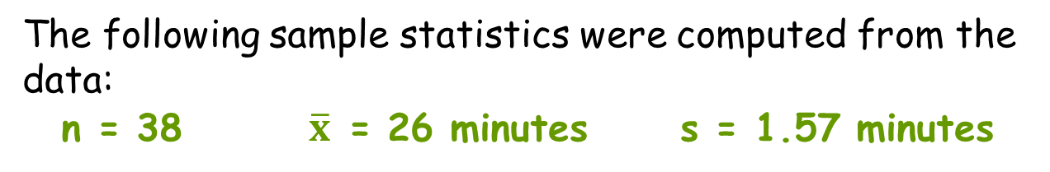
During a flu outbreak, many people visit emergency rooms. Before being treated, they often spend time in crowded waiting rooms where other patients may be exposed. A study was performed investigating a drive-through model where flu patients are evaluated while they remain in their cars.
Researchers were interested in estimating the mean processing time for flu patients using the drive-through model.
Use 95% confidence to estimate this mean.
In the study, 38 people were each given a scenario for a flu case that was selected at random from the set of all flu cases actually seen in the emergency room. The scenarios provided the “patient” with a medical history and a description of symptoms that would allow the patient to respond to questions from the examining physician.
The patients were processed using a drive-through procedure that was implemented in the parking structure of Stanford University Hospital. The time to process each case from admission to discharge was recorded.
The following sample statistics were computed from the data:
n = 38 $\overline{x}$ = 26 minutes s = 1.57 minutes

Slide 20
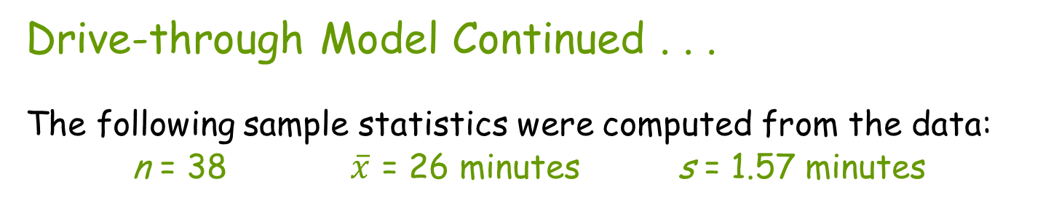
Drive-through Model Continued . . .
The following sample statistics were computed from the data:
n = 38 $\overline{x}$ = 26 minutes s = 1.57 minutes
Degrees of freedom = 37; for 95%, t = 2.0262
We are 95% confident that the interval (25.484, 26.516) contains the true mean processing time for emergency room flu cases using the drive-thru model.

Slide 21
Determining Sample Size to Estimate μ

Slide 22
Required Sample Size To Estimate a Population Mean μ
If you desire a C% confidence interval for a population mean μ with an accuracy specified by you, how large does the sample size need to be?
We will denote the accuracy by ME, which stands for Margin of Error.

Slide 23
Example: Sample Size to Estimate a Population Mean μ
Suppose we want to estimate the unknown mean height μ of male students at NC State with a confidence interval.
We want to be 95% confident that our estimate is within .5 inch of μ
How large does our sample size need to be?

Slide 24
Confidence Interval for μ

Slide 25
Good news: we have an equation
Bad news:
  Need to know s
  We don’t know n so we don’t know the degrees of freedom to find t*_{n-1}

Slide 26
A Way Around this Problem: Use the Standard Normal

Slide 27
Estimating s
Previously collected data or prior knowledge of the population
If the population is normal or near-normal, then s can be conservatively estimated by
s ≈ range
6
99.7% of obs. Within 3 σ of the mean

Slide 28
Example: sample size to estimate mean height µ of NCSU undergrad. male students
We want to be 95% confident that we are within .5 inch of μ, so
  ME = .5; z*=1.96
Suppose previous data indicates that s is about 2 inches.
n= [(1.96)(2)/(.5)]² = 61.47
We should sample 62 male students

Slide 29


Example: Sample Size to Estimate a Population Mean μ-Textbooks
Suppose the financial aid office wants to estimate the mean NCSU semester textbook cost μ within ME=$25 with 98% confidence. How many students should be sampled? Previous data shows σ is about $85.

Slide 30





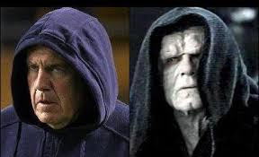
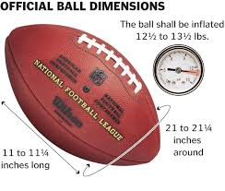



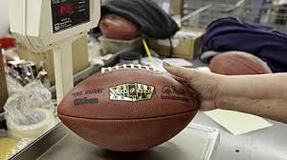
Example: Sample Size to Estimate a Population Mean μ-NFL footballs
The manufacturer of NFL footballs uses a machine to inflate new footballs
The mean inflation pressure is 13.0 psi, but random factors cause the final inflation pressure of individual footballs to vary from 12.8 psi to 13.2 psi
After throwing several interceptions in a game, Tom Brady complains that the balls are not properly inflated.
The manufacturer wishes to estimate the mean inflation pressure to within .025 psi with a 99% confidence interval. How many footballs should be sampled?

Slide 31
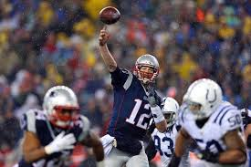

Example: Sample Size to Estimate a Population Mean μ
The manufacturer wishes to estimate the mean inflation pressure to within .025 pound with a 99% confidence interval. How may footballs should be sampled?
99% confidence ⇒ z* = 2.58; ME = .025
σ = ? Inflation pressures range from 12.8 to 13.2 psi
So range =13.2 – 12.8 = .4; σ ≅ range/6 = .4/6 = .067
. . .
1
2
3
48

Slide 32
Chapter 23
Testing Hypotheses
about Means
32

Slide 33

Sweetness in cola soft drinks
Cola manufacturers want to test how much the sweetness of cola drinks is affected by storage. The sweetness loss due to storage was evaluated by 10 professional tasters by comparing the sweetness before and after storage (a positive value indicates a loss of sweetness):
Taster Sweetness loss
1 2.0
2 0.4
3 0.7
4 2.0
5 −0.4
6 2.2
7 −1.3
8 1.2
9 1.1
10 2.3
We want to test if storage results in a loss of sweetness, thus:
H₀: μ = 0 versus H_{A}: μ > 0
where m is the mean sweetness loss due to storage.
We also do not know the population parameter s, the standard deviation of the sweetness loss.

Slide 34
The one-sample t-test
As in any hypothesis tests, a hypothesis test for μ requires a few steps:
  State the null and alternative hypotheses (H₀ versus H_{A})
    Decide on a one-sided or two-sided test
  Calculate the test statistic t and determining its degrees of freedom
  Find the area under the t distribution with the t-table or technology
  State the P-value (or find bounds on the P-value) and interpret the result

Slide 35
The one-sample t-test; hypotheses
Step 1:
  State the null and alternative hypotheses (H₀ versus H_{A})
    Decide on a one-sided or two-sided test
  H₀: μ = μ₀ versus H_{A}: μ > μ₀ (1 –tail test)
  H₀: μ = μ₀ versus H_{A}: μ < μ₀ (1 –tail test)
  H₀: μ = μ₀ versus H_{A}: μ ≠ μ₀ (2 –tail test)

Slide 36
The one-sample t-test; test statistic
We perform a hypothesis test with null hypothesis
H₀ : μ = μ₀ using the test statistic
where the standard error of is .
When the null hypothesis is true, the test statistic follows a t distribution with n-1 degrees of freedom. We use that model to obtain a P-value.

Slide 37
The one-sample t-test; P-Values
Recall:
The P-value is the probability, calculated assuming the null hypothesis H₀ is true, of observing a value of the test statistic more extreme than the value we actually observed.
The calculation of the P-value depends on whether the hypothesis test is 1-tailed
(that is, the alternative hypothesis is
H_{A} :μ < μ₀ or H_{A} : μ > μ₀)
or 2-tailed
(that is, the alternative hypothesis is H_{A} : μ ≠ μ₀).
37
Notes:
QTM1310/ Sharpe
37

Slide 38
P-Values
Assume the value of the test statistic t is t₀
If H_{A}: μ > μ₀, then P-value=P(t > t₀)
If H_{A}: μ < μ₀, then P-value=P(t < t₀)
If H_{A}: μ ≠ μ₀, then P-value=2P(t > |t₀|)
38
Notes:
QTM1310/ Sharpe
38

Slide 39
Sweetening colas (continued)
Is there evidence that storage results in sweetness loss in colas?
H₀: μ = 0 versus H_{a}: μ > 0 (one-sided test)
Taster Sweetness loss
1 2.0
2 0.4
3 0.7
4 2.0
5 -0.4
6 2.2
7 -1.3
8 1.2
9 1.1
10 2.3
___________________________
Average 1.02
Standard deviation 1.196
Degrees of freedom n − 1 = 9
Conf. Level | 0.1 | 0.3 | 0.5 | 0.7 | 0.8 | 0.9 | 0.95 | 0.98 | 0.99
Two Tail | 0.9 | 0.7 | 0.5 | 0.3 | 0.2 | 0.1 | 0.05 | 0.02 | 0.01
One Tail | 0.45 | 0.35 | 0.25 | 0.15 | 0.1 | 0.05 | 0.025 | 0.01 | 0.005
df |  |  |  |  | Values of t
9 | 0.1293 | 0.3979 | 0.7027 | 1.0997 | 1.3830 | 1.8331 | 2.2622 | 2.8214 | 3.2498
2.2622 < t = 2.70 < 2.8214; thus 0.01 < P-value < 0.025.
Since P-value < .05, we reject H₀. There is a significant loss of sweetness, on average, following storage.

Slide 40
New York City Hotel Room Costs
The NYC Visitors Bureau claims that the average cost of a hotel room is $168 per night. A random sample of 25 hotels resulted in
y = $172.50 and
s = $15.40.
H₀: μ = 168 H_{A}: μ ≠ 168

Slide 41
New York City Hotel Room Costs
H₀: μ = 168 H_{A}: μ ≠ 168
t, 24 df
.079
.079
n = 25; df = 24
0
-1. 46
1. 46
P-value = .158
Conf. Level | 0.1 | 0.3 | 0.5 | 0.7 | 0.8 | 0.9 | 0.95 | 0.98 | 0.99
Two Tail | 0.9 | 0.7 | 0.5 | 0.3 | 0.2 | 0.1 | 0.05 | 0.02 | 0.01
One Tail | 0.45 | 0.35 | 0.25 | 0.15 | 0.1 | 0.05 | 0.025 | 0.01 | 0.005
df |  |  |  |  | Values of t
24 | 0.1270 | 0.3900 | 0.6848 | 1.0593 | 1.3178 | 1.7109 | 2.0639 | 2.4922 | 2.7969
Do not reject H₀: not sufficient evidence that true mean cost is different than $168

Slide 42


Microwave Popcorn
A popcorn maker wants a combination of microwave time and power that delivers high-quality popped corn with less than 10% unpopped kernels, on average. After testing, the research department determines that power 9 at 4 minutes is optimum. The company president tests 8 bags in his office microwave and finds the following percentages of unpopped kernels: 7, 13.2, 10, 6, 7.8, 2.8, 2.2, 5.2.
Do the data provide evidence that the mean percentage of unpopped kernels is less than 10%?
H₀: μ = 10
H_{A}: μ < 10
where μ is true unknown mean percentage of unpopped kernels

Slide 43
Microwave Popcorn
t, 7 df
H₀: μ = 10 H_{A}: μ < 10
.02
n = 8; df = 7
0
-2. 51
Exact P-value = .02
Conf. Level | 0.1 | 0.3 | 0.5 | 0.7 | 0.8 | 0.9 | 0.95 | 0.98 | 0.99
Two Tail | 0.9 | 0.7 | 0.5 | 0.3 | 0.2 | 0.1 | 0.05 | 0.02 | 0.01
One Tail | 0.45 | 0.35 | 0.25 | 0.15 | 0.1 | 0.05 | 0.025 | 0.01 | 0.005
df |  |  |  |  | Values of t
7 | 0.1303 | 0.4015 | 0.7111 | 1.1192 | 1.4149 | 1.8946 | 2.3646 | 2.9980 | 3.4995
Reject H₀: there is sufficient evidence that true mean percentage of unpopped kernels is less than 10%

